Slide 1

QA Testing and Automation for the Tasks Android App
This presentation outlines our comprehensive Quality Assurance (QA) project for the Tasks Android application. We will cover the project overview, detailed test plan, various test artifacts, and a summary of our activities and improvements. Our goal was to ensure the app's functionality, reliability, and performance through a structured testing approach.
Instructor: Dr. Faisal Shehadeh

Slide 2
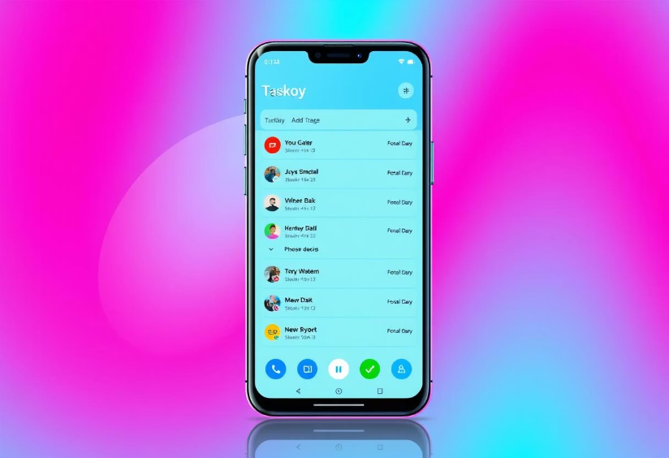

Project Overview: Tasks Android App
Application Description
The Tasks Android app is an open-source productivity tool built with Kotlin and Java, following an MVVM architecture. It supports CalDAV sync and offers robust task management features, making it an ideal candidate for comprehensive testing across functional, structural, performance, and regression aspects.
Our project focused on ensuring the quality and reliability of this widely used application. We aimed to cover all major functionalities and identify potential issues through various testing methodologies.

Slide 3

Functional Requirements (FR)
1
Task Management
Users can create, edit, mark as complete, restore, delete, duplicate, and move tasks.
2
Task Details & Reminders
Tasks support titles, due dates, priorities, descriptions, subtasks, file attachments, tags, and location-based reminders.
3
Notifications & Recurrence
The app displays notifications for reminders and supports customizable repeating tasks.
4
Data Sync & Offline
Tasks can sync with external calendar services (Google Calendar, CalDAV) and support offline editing.

Slide 4





Non-Functional Requirements (NFR)
Platform & Compatibility
Performance & Responsiveness
Offline & Reliability
Full offline functionality for core features, reliable reminders in background, graceful crash recovery.
Supports Android 8.0+ (API 26), developed with Kotlin/Java, SDK 21, MVVM, and Room Database.
Main screen launches within 2 seconds; notifications are delivered reliably and punctually.
UI & Accessibility
Provides dark/light themes and supports UI scaling for different screen sizes.

Slide 5
Test Plan & Strategy
Scope of Testing
Test Strategy
Our testing covered task creation, editing, deletion, reminders, filtering, and settings. We applied static, black-box, white-box, regression, automation, and performance testing types.
We employed a combination of manual and automated testing:
Static testing on core classes.
White-box testing with JUnit for logic methods.
Test Objectives
Black-box testing via UI for task operations.
Functional testing ensured users can create, edit, and delete tasks. Performance testing verified app efficiency with multiple tasks.
Regression testing after code changes.
Automation testing using Appium for core flows.
Performance testing using JMeter.

Slide 6

Static Code Inspection Findings
Task.kt
Identified issues like public fields, missing equals/hashCode overrides, lack of Javadoc, and redundant sync logic. Recommendations include encapsulation and modularization.
TaskEditViewModel.kt
Noted the save() method's complexity, duplicated alarm logic, and silent sync failures. Suggested refactoring into smaller functions and improving error notification.
DateTime.kt
Found inefficiencies in constructor/getters (recreating GregorianCalendar), mutable fields, and lack of input validation. Recommended caching and immutability.
MainActivityViewModel.kt
Identified good readability and maintainability but suggested replacing runBlocking calls, adding KDoc comments, and extracting magic numbers.

Slide 7
Black-Box Test Case Designs
Test Case ID
Title
Description
Status
BTC01
Add task with valid data
Verify successful task saving with valid input.
Passed
BTC02
Edit existing task Name
Verify task title updates correctly.
Passed
BTC03
Set reminder for a task
Verify reminder setup triggers correctly.
Passed
BTC04
Mark task as completed
Verify task moves to completed list.
Passed
BTC05
Create Task with Empty Title
Verify task created with default title.
Passed
BTC06
Set Past Due Date
Verify system handles past due dates with warning.
Passed
BTC07
Discard Task – Confirm Discard Dialog
Verify confirmation dialog before discarding unsaved changes.
Passed
BTC08
Attach Photo to Task
Verify successful photo attachment.
Passed
BTC10
Create Task with Invalid Leap Day
Verify app rejects non-existent leap day.
Passed
BTC12
Create Task with Invalid Day (Day = 00)
Verify app rejects day value of zero.
Passed

Slide 8
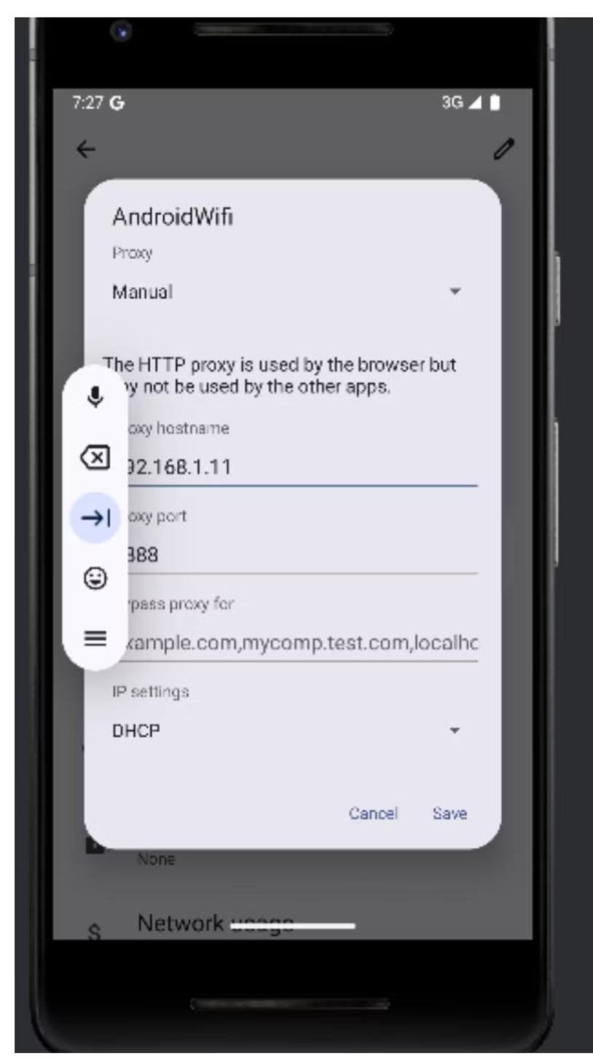
Performance Testing with JMeter
Objective & Setup
We used Apache JMeter (v5.6.3) to simulate mobile user behavior and analyze app responses under concurrent actions like task creation and reminder triggers. The setup involved configuring a local Wi-Fi proxy (port 8888) on an Android emulator (IP 192.168.1.11) to capture HTTP/HTTPS requests.
Observations showed all requests executed under 200ms, and CPU usage remained stable, indicating no significant bottlenecks for basic operations. JMeter effectively simulated typical user traffic, confirming the app's stability under light load.

Slide 9

Summary of Activities and Improvements
Comprehensive QA Process
Our team executed a structured QA process, starting with detailed requirement analysis to define expected behavior and identify key features for coverage.
Diverse Testing Methodologies
We conducted static code analysis, designed black-box and white-box test cases, and utilized JUnit for unit testing. JMeter was employed for performance testing to evaluate load handling.
Jira for Test Management
Jira served as our primary tool for managing test execution, bug reports, and progress, ensuring clear traceability and collaboration across the team.
Successful Regression Testing
Regression testing re-verified stable features after code updates, confirming no new bugs or affected functionalities were introduced, maintaining system stability.

Slide 10
Team Responsibilities
Anas Al Sayed
Abd Al-Raheem Yaseen
Rakan Omar
Led requirement analysis, static testing, and designed detailed black-box and white-box test cases.
Focused on regression testing, static reviews, and designing comprehensive edge-case black-box tests.
Specialized in static testing and validating date and time logic, including invalid leap day scenarios.
Ahmad Rimawi
Mohammad Nemer
Managed test cases in Jira, ensuring traceability, and performed static testing on ViewModel logic.
Conducted JMeter-based performance testing and reviewed UI fragment responsiveness and risk documentation.

Slide 11
Thank You
We appreciate your time and attention today. Our team is committed to continuous improvement and delivering robust solutions. We welcome any questions you may have.

